Slide 1
Advancing STEM Talent at Baxter Marcus Schabacker, CVP Chief Scientific Officer

Slide 2
Baxter Overview

Slide 3
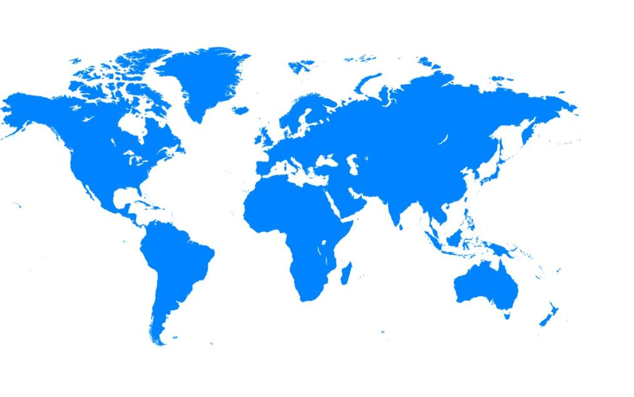
Baxter’s mission is to save and sustain lives
United States
Headquartered in Illinois
More than 15,000 employees
IN THE HOSPITAL
Latin America and Canada
Nearly 9,100 employees
Europe, Middle East and Africa Nearly 10,000 employees
IN THE CLINIC
Asia Pacific
More than 11,000 employees
2014 Revenue: $10.7B
Our global footprint helps us provide essential products to patients and healthcare providers in more than 100 countries
IN THE HOME

Slide 4
STEM Talent is Critical for Our Business
Drug Delivery
Hardware & Software Development
Polymers and Container Technology
Biologics
Solutions
Sterilization
We rely on STEM talent to advance patient care

Slide 5
STEM Talent Landscape

Slide 6
STEM Talent Landscape
Lack of diversity in STEM
Undergraduates are leaving STEM
Challenges in attracting, engaging and developing STEM talent – particularly early in career
Millennials provide a good opportunity for STEM diversity

Slide 7
How Baxter Attracts, Engages and Develops Diverse STEM Talent

Slide 8
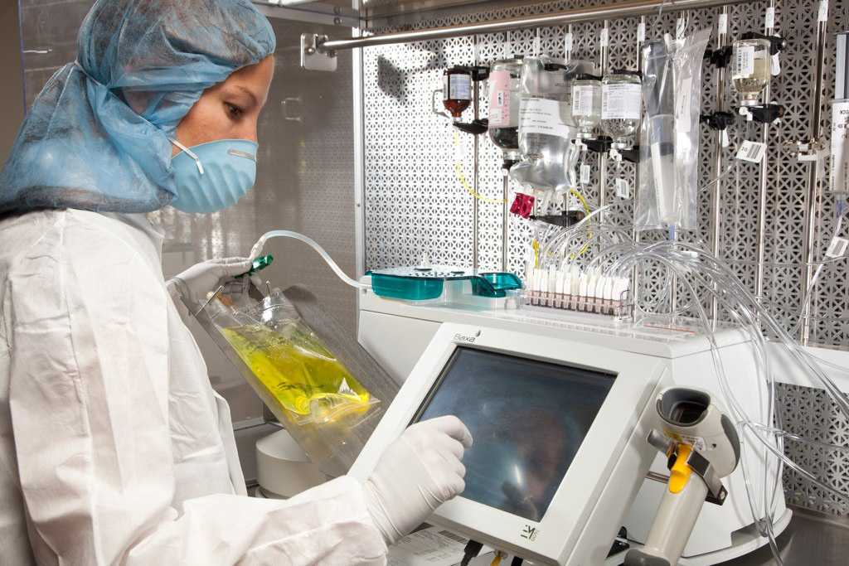
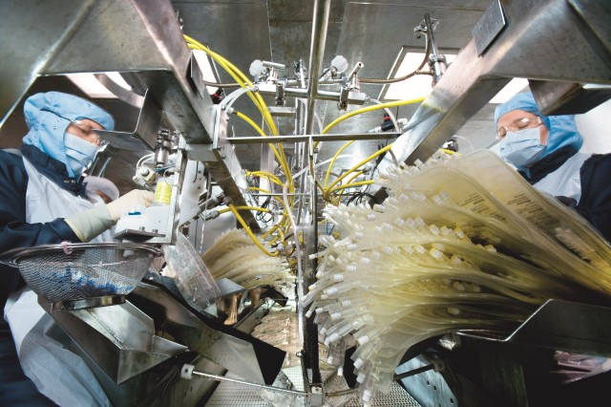
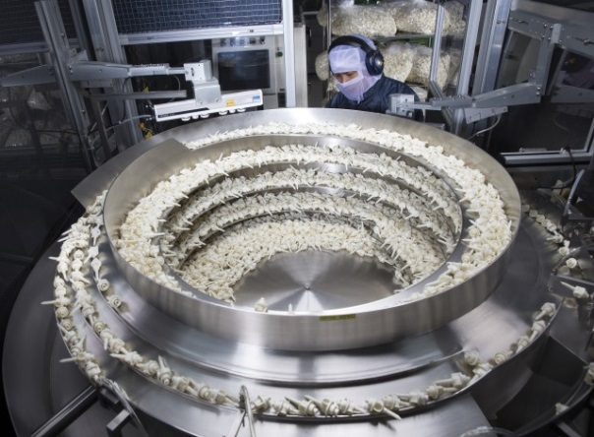
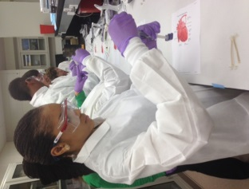
How Baxter Attracts, Engages and Develops Diverse STEM Talent
Career Development
Early Talent Technical Development Program
Intern and Co-Op Program
Elementary, High School and College

Slide 9
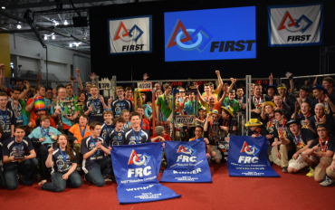
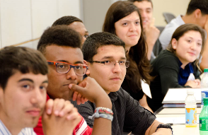
Generate STEM Interest and Engage with Diverse Students
Baxter’s Commitment To Math And Science Education:
Engage with students on STEM-related projects, programs, and research
First Robotics competition
Elementary, High School and College
Science@Work high school visit

Slide 10
Science@Work: Demonstrating Impact

Slide 11
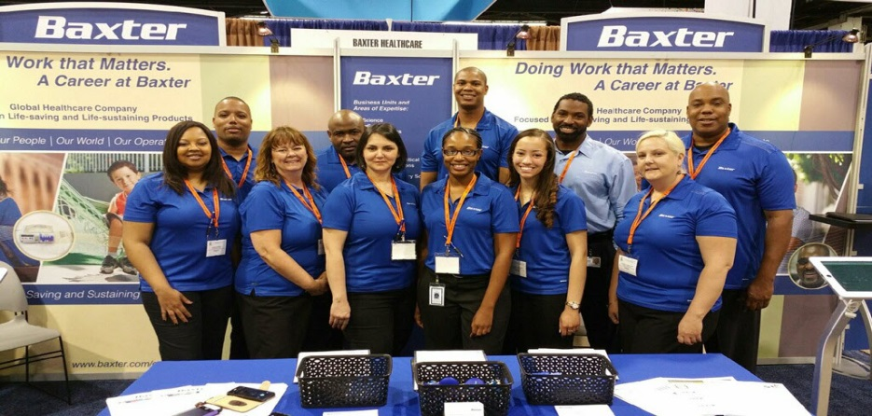
Attract, Engage and Develop a Diverse Pool of STEM Talent
Attract, engage and develop pool of top talent for Baxter’s Early Talent Program and other open Baxter positions
Intern and Co-Op Program
Baxter recruiting for new talent at a National Society of Black Engineers event.
We attract diversity with diversity.

Slide 12
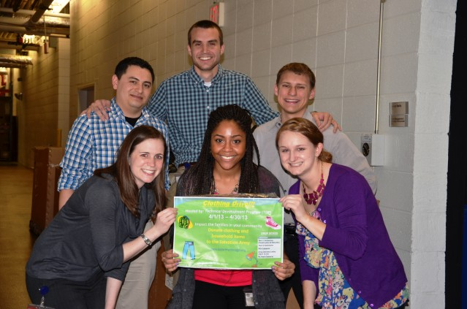
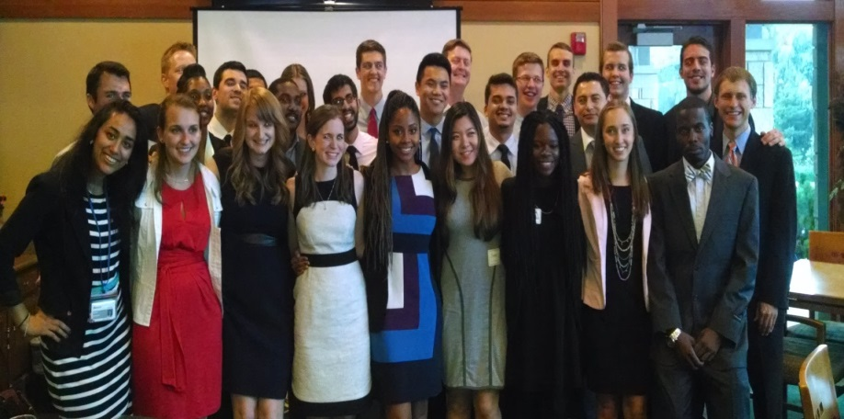
Develop Future STEM Leaders
Develop future Baxter leaders prepared to design and produce Baxter’s next generation of products
Early Talent Technical Development Program
Technical Development Program community volunteers.
Technical Development Program community volunteers.
Technical Development Program graduates and alumni.

Slide 13
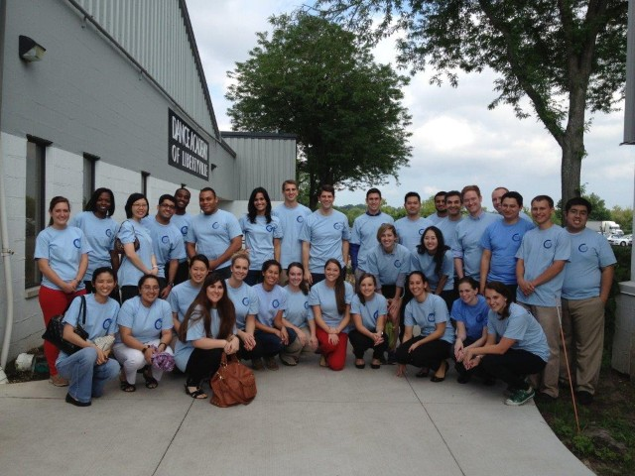
Attracting, Engaging and Growing Millennial STEM Talent at Baxter
Technical Development Program and Early Career Professional Members community volunteers.
Sense of Community
Give Back
Be Heard
Growth & Development
Work/Life “Weave”
Recognition

Slide 14
Create a Sense of Community with Diverse Talent
Baxter Business Resource Groups: Helping Baxter employees achieve professional development aspirations and drive awareness and engagement across diverse employee groups
Career Development

Slide 15
Questions?

Slide 16
Thank You!

