Slide 1

Digital Recruitment
@HRCharlie

Slide 2
Online Diversity Strategy Objectives
Build awareness as a “Best Place to Work”
Enlist, engage and empower employees as Talent Ambassadors
Build recruiter capabilities
Leverage all recruiting networks available
Engage with candidates where they are

Slide 3
Our Network
Web Properties & Social Media Channels
Branding
Employer of Choice
Content Management
Inside MasterCard
Your Network
Social Media Ambassadors
Awareness
Invite to Engage
Multiplier Effect
New Network
Direct Sourcing & Engagement
Recruiter Training
Search Techniques
Diversity “Library”

Slide 4
Our Network
Web Properties & Social Media Channels
Branding
Employer of Choice
Content Management
Inside MasterCard
Your Network
Social Media Ambassadors
Awareness
Invite to Engage
Multiplier Effect
New Network
Direct Sourcing & Engagement
Recruiter Training
Search Techniques
Diversity “Library”

Slide 5
Define Employment Brand
AN EMPLOYMENT BRAND THAT
IS IN SYNC WITH OUR BRAND
Connecting People to Priceless Possibilities
WHAT MATTERS TO EMPLOYEES
Force for Good
Globality
The Whole You
Creative & Innovative Culture
Career Development
Modern Culture

Slide 8









Content Management
Identify all sites and channels
Retire, reclaim and manage
Create content calendar and strategy
No web or social properties can be static

Slide 9
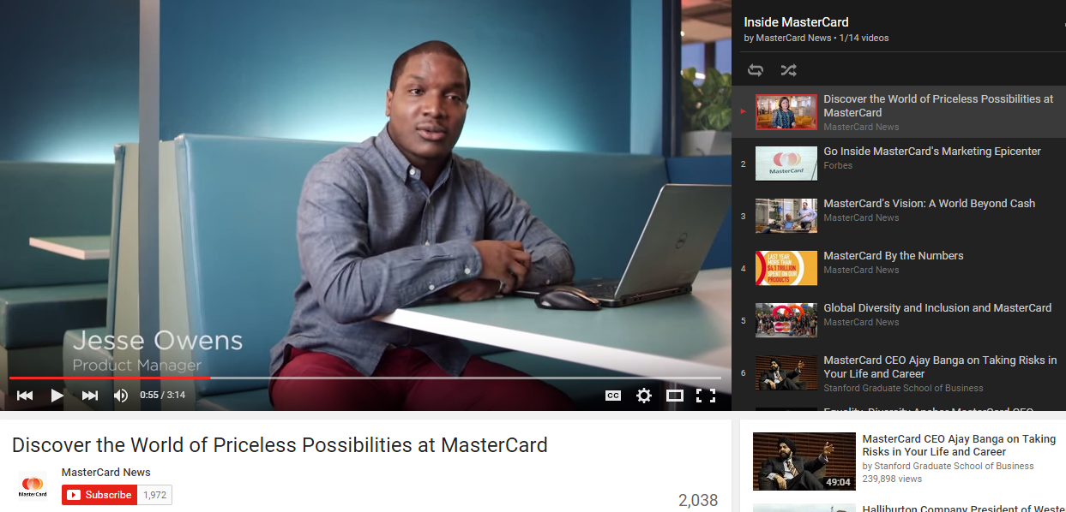
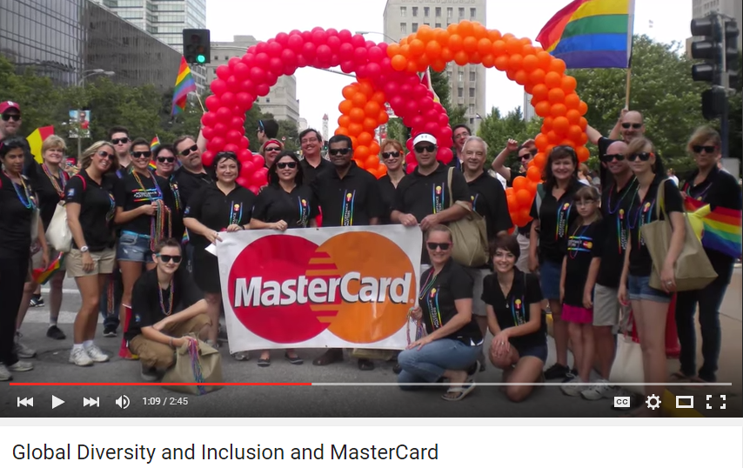
A YouTube playlist for direct candidate messaging and branding

Slide 10
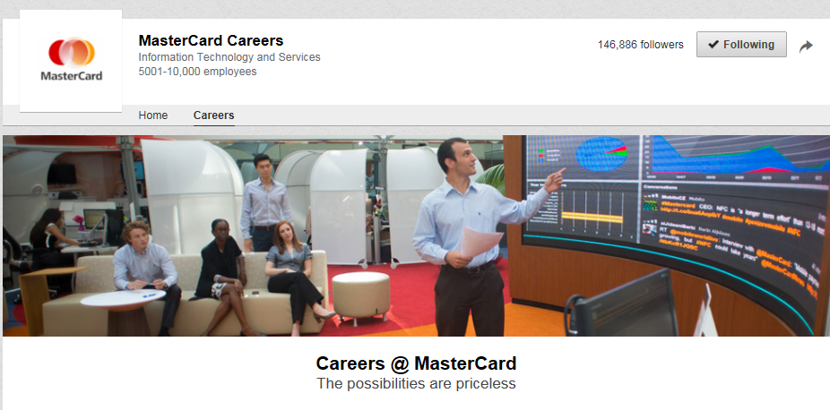
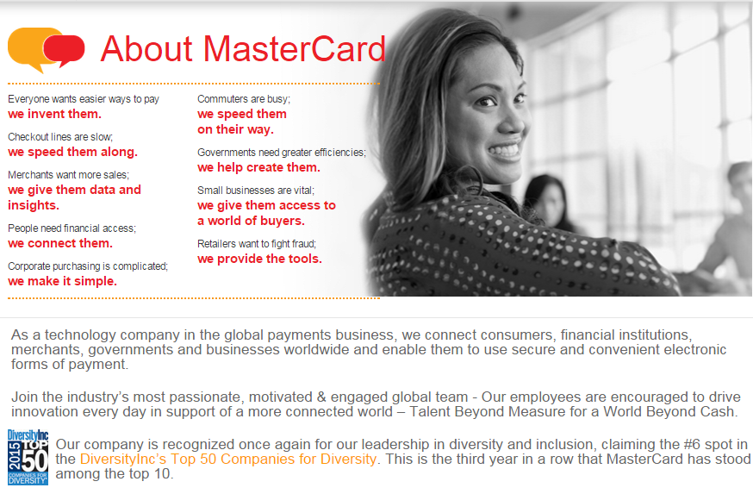
Updating branding on Direct Employers increased candidate flow by 92%
Updated LinkedIn branding & targeted career pages increased “apply clicks” by 84%

Slide 11
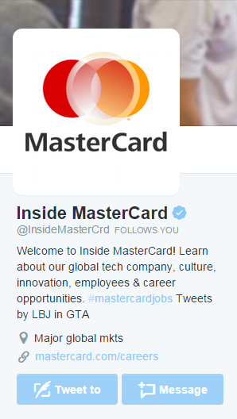

Candidate response to Twitter Cards averages 78% higher than regular job posts
Social posts unique candidate reach has increased by 110% since launch

Slide 12
Our Network
Web Properties & Social Media Channels
Branding
Employer of Choice
Content Management
Inside MasterCard
Your Network
Social Media Ambassadors
Awareness
Invite to Engage
Multiplier Effect
New Network
Direct Sourcing & Engagement
Diversity “Library”
Search Techniques
Tools, Alerts & Saved Searches

Slide 13

New Hire Welcome Letter
Business Resource Groups
Hiring Manager
How To
Recruiter Social Media Training
Employees as Talent Ambassadors
Increase in Glassdoor activity by 316%
10x the unique candidate reach
Overall reach has increased by 70%

Slide 14
Our Network
Web Properties & Social Media Channels
Branding
Employer of Choice
Content Management
Inside MasterCard
Your Network
Social Media Ambassadors
Awareness
Invite to Engage
Multiplier Effect
New Network
Direct Sourcing & Engagement
Recruiter Training
Search Techniques
Diversity “Library”

Slide 15



Recruiter Search Training

Slide 16


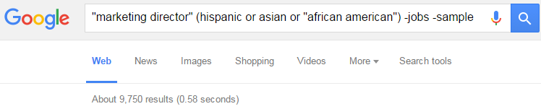
Basic Boolean
And | Requires all terms
Or | Returns either terms
Not / - | Eliminates terms
“ ” | Returns exact phrase
( ) | Subset of a search
* | Wildcard

Slide 17
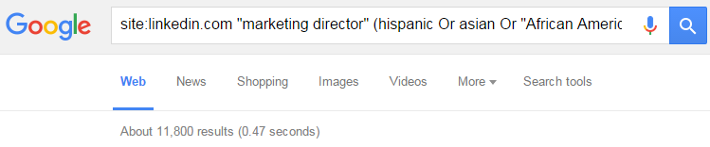
Advanced Boolean
Intitle: | Keywords in title
Inurl: | Keywords in url
Site: | “Xray search” a website
Related: | Finds similar sites

Slide 18
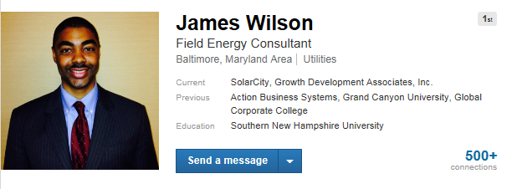






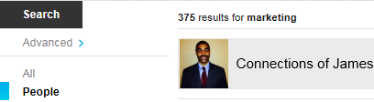

James --------
Director of Marketing
Your connections have connections
Indirect search techniques
Boolean searches work in LinkedIn
You can X-Ray LinkedIn
Connections of James

Slide 19

Additional Tips & Results
Develop a search library
Search terms
Search strings
Create search alerts
Leverage training & support
AIRS, LinkedIn
Dedicate time to strategic sourcing & experiment with various search strings
20% of Sourcers time is spent on strategic pipelining
Direct sourced hires have increased by 127%
Direct sourced diverse hires have increased by 105%

Slide 20
Final Recommendations
Build a branding foundation
Engage employees as Talent Ambassadors
Build recruiter capabilities
Leverage all recruiting networks available

