Slide 1
Committed to Creating Healthier Communities
David Casey Vice President, Workforce Strategies and Chief Diversity Officer, CVS Health
October 1, 2015
Notes:
Thank you all for that warm welcome. I’m pleased to be with you here in Newark. As you may know, it’s been an exciting year for CVS Health! Last month on September 3, we celebrated the one year anniversary of our tobacco exit. As you may remember, in February 2014, we announced we would end the sale of cigarettes and tobacco products in our CVS/pharmacy stores. Then in September, we announced we were officially tobacco free – one month earlier than planned. At the same time, we changed our corporate name to CVS Health to reflect our broader health care commitment and our expertise in driving the innovations needed to shape the future of health.
Today, I’ll provide you some insight on what led to our decision to make these landmark changes and share some information on the innovations we are making in health care delivery because our company purpose to help people on their path to better health didn’t end with quitting tobacco. First though, I’ll share just a little bit of our company story with you.

Slide 2
Today’s agenda
How CVS Health’s purpose-driven decisions (e.g. tobacco cessation, Baltimore reopening) resonate with communities and customers and help position our evolution in the market to a healthcare company.

Slide 3
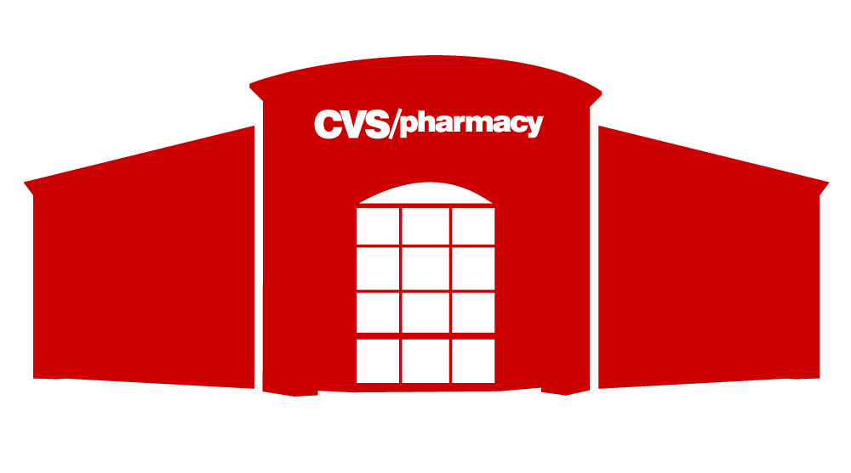
Who we are today
more than
7,800 stores and 5 million customers per day
25.6 million visits on CVS.com per month
Nearly 1,000
MinuteClinics in 31 states and DC with more than 25+ million patient visits
70 million PBM members
© 2015 CVS Health Confidential & Proprietary
Notes:
As we evolved from a retailer to a pharmacy innovation company, we took time to examine our mission, vision and values so they’d reflect the company we had become. What we came up with was a purpose and strategy that tell the world who we are.
Our purpose is helping people on their path to better health.
Every action we take and decision we make is viewed through the filter of this purpose – it guides everything we do.
Our strategy is reinventing pharmacy to provide caring, expert guidance, new cost-effective solutions and even more convenient access to care.
And our values - innovation, collaboration, caring, integrity, and accountability - along with our purpose - are what guide us each day.
CVS Health includes the company’s retail business, which continues to be called CVS/pharmacy; our pharmacy benefit management business, which is known as CVS/caremark; our walk-in medical clinics, CVS/minuteclinic; and our growing specialty pharmacy services, CVS/specialty.
Today, we are a pharmacy innovation company with 7,800 stores, serving 5 million customers each day. And, we provide prescription benefits to more than 70 million people. We deliver leading clinical programs to help people adhere to the medication regimen their doctor has prescribed, and innovative plan designs to help clients and members effectively manage drug spend.
We’re also the leader in retail medical clinics with nearly 1,000 clinics in 31 states and Washington, DC, which have served 25+ million patients since 2000.

Slide 4
Our tobacco exit
≠
© 2015 CVS Health Confidential & Proprietary
Notes:
In large part, our purpose was at the core of our decision to quit tobacco in September 2014.
There’s no question that tobacco use hurts people on their path to better health.
And it’s a significant public health threat.
Consider these statistics (next slide):

Slide 5
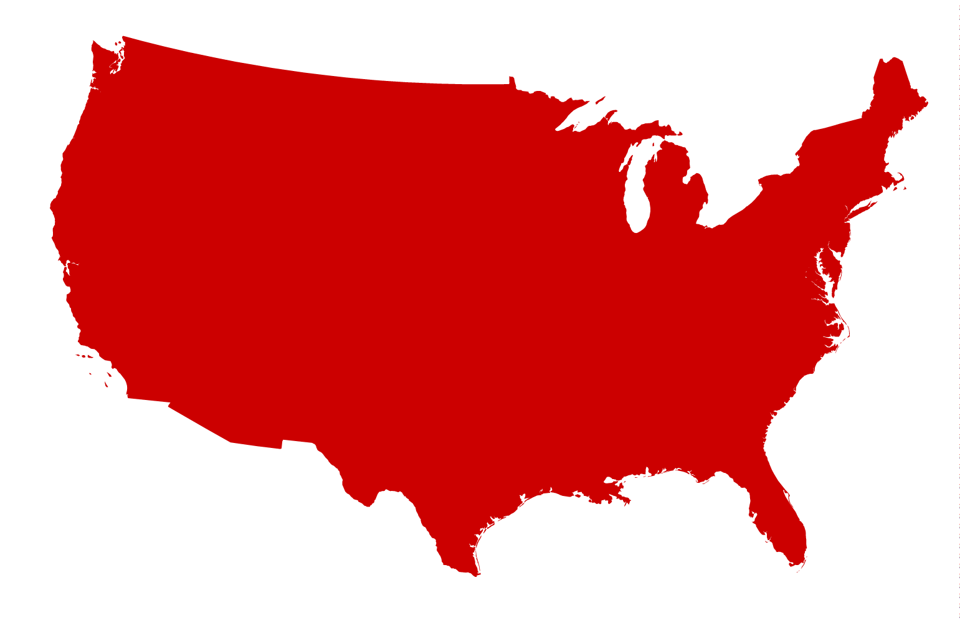
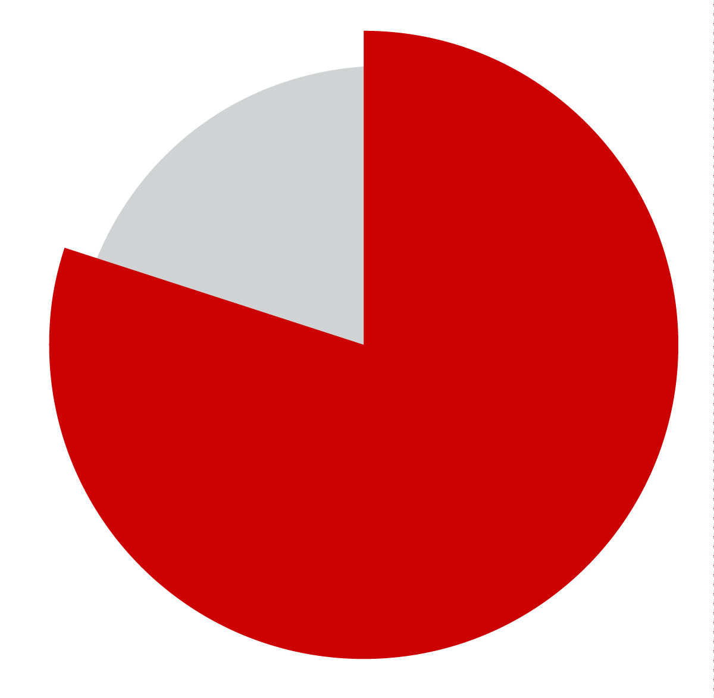
Facts and figures
smokers die approximately
than non-smokers
480,000
14 years earlier
80%
deaths
from smoking in the
United States annually
of smokers start as kids
42 million American adults and
3 million middle and high school students still smoke
$300 billion annual estimated economic costs
9 in 10 lung cancers are caused by smoking
Notes:
480,000 people die each year from tobacco-related illness; smokers die approximately 14 years earlier than non-smokers.
42 million American adults and 3 million middle and high school students continue to smoke.
Smoking causes 87% of lung cancer deaths and 79% of all cases of COPD – Chronic Obstructive Pulmonary Disease.
The economic cost attributed to smoking and exposure to smoke is approaching $300 billion annually.

Slide 6
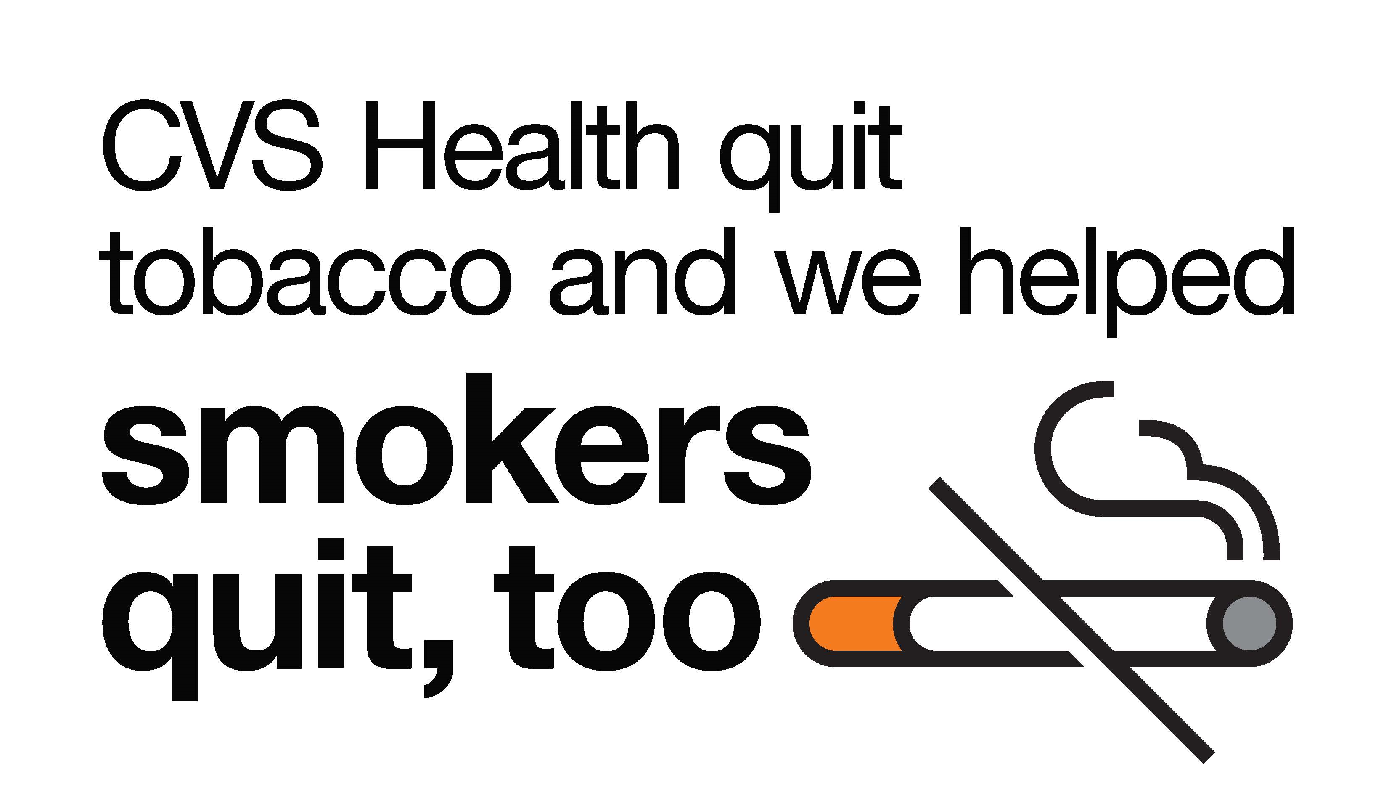
Tobacco exit impact
Notes:
As we recently marked the first anniversary of ending tobacco sales, we released new data that showed a positive impact of our decision in communities across the U.S.
In fact, in states where CVS/pharmacy had a 15 percent or greater share of the retail pharmacy market, we saw an additional one percent reduction in cigarette pack sales across retailers following our decision to stop selling tobacco products, compared to states with no CVS/pharmacy stores. This equates to 95 million fewer packs of cigarettes sold or 5 fewer packs per smoker.
In addition, in those same states, we saw a four percent increase in nicotine patch purchases indicating a positive effect on quit attempts by smokers.

Slide 7
We didn’t stop there…
Notes:
You all know we quit smoking, but we aren’t stopping there.
We serve millions of people every day by playing an active, supportive role in each person’s unique health experience.
For them and us, health is everything.
We are a purpose-driven company, and we’re committed to our customers, colleagues and the communities in which they live and work. As such:
We’ve expanded our corporate social responsibility efforts to support health and wellness initiatives;
We’re rebuilding and reopening our stores in Baltimore so we can continue to serve that community devastated by the riots earlier this year
We’re offering healthier products in our stores and innovating pharmacy care to help people lead healthier lives; and
We’re building a strong, next generation workforce by supporting apprenticeships and our more than 200,000 employees.

Slide 8
Helping people be tobacco-free
American Lung Association’s LUNG FORCE
Campaign for Tobacco-Free Kids’ Making the Next Generation Tobacco-Free
Scholastic’s Get Smart About Tobacco!
Notes:
In addition to our own smoking cessation program and efforts to reduce access to tobacco products, we are committed to helping people lead tobacco-free lives through our philanthropic support of nonprofit organizations aligned with our purpose.
Following the announcement of our tobacco-exit, we aligned our support with our commitment to help people lead tobacco-free lives. We are proud to be the national presenting sponsor of the American Lung Association’s LUNG FORCE campaign aimed at making lung cancer in women a public health priority, driving policy change and increasing research funding. We’ve donated more than $7 million to support this cause since it launched in 2014.
We have also made a $5 million five-year commitment to the Campaign for Tobacco Free Kids to launch its new "Making the Next Generation Tobacco-Free" grant program. Through the program, the CVS Health Foundation will partner with Tobacco-Free Kids to provide grants to organizations committed to implementing public health strategies to reduce youth tobacco use and exposure to secondhand smoke.
Most recently, we’ve launched a joint initiative with Scholastic called “Get Smart About Tobacco!” as part of our ongoing commitment to making the next generation tobacco-free. This school-based tobacco prevention curriculum is aimed at preventing youth smoking while teaching children about the many health consequences of tobacco use.
“Get Smart About Tobacco!” will reach nearly 3 million children in grades 3 to 5 when it begins this fall. A second component for grades 6 and 7 will be introduced in select pilot markets in early 2016.

Slide 9
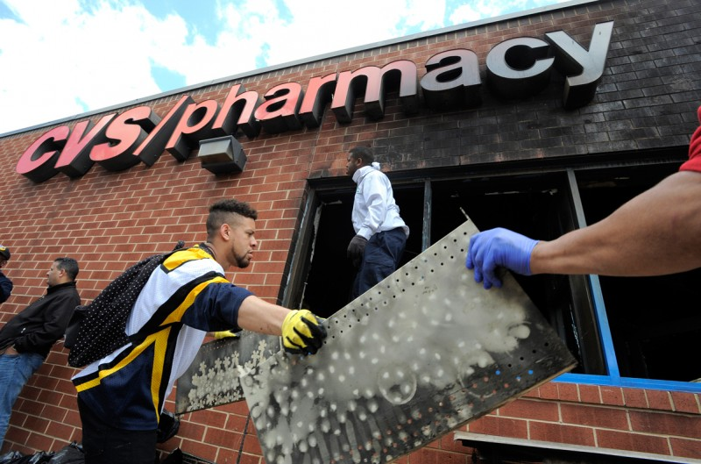
Rebuilding in Baltimore
Notes:
Our purpose as a company is helping people on their path to better health. During the protests in Baltimore earlier this year, two of our stores sustained heavy fire damage.
We knew there was no better way of fulfilling our company’s purpose than to reopen our doors and get back to serving the community. It’s simply the right thing to do.
CVS/pharmacy has been serving customers in Baltimore since the mid-1990s where it now has nearly 30 stores and more than 500 employees.
When these stores reopen later this year, we will be providing our customers and patients an enhanced selection of groceries and healthy food options along with the quality pharmacy care they have come to depend upon from CVS/pharmacy. We’re looking forward to welcoming customers back and to be apart of the neighborhood again.
As a further sign of our commitment to helping the community recover and thrive, CVS Health Foundation made a $100,000 donation to the United Way of Central Maryland “Maryland Unites Fund” and the Baltimore Community Foundation “Fund for Rebuilding Baltimore.”
These funds will help provide immediate and longer-term support to people in hard-hit areas and give those communities much-needed resources.

Slide 10
Key CSR Pillar – Health in Action
Over $5 million in grants to:
Improve accessible and affordable health care
Support people with chronic diseases
Improve well-being and safety
Notes:
Our approach to corporate social responsibility ties directly to our business purpose of helping people on their path to better health. One of the key pillars of our CSR strategy is called “Health in Action,” which prioritizes accessible and affordable health care, support for patients with chronic diseases and patient and customer well-being and safety.
Earlier in 2015, the CVS Health Foundation announced 55 new grant recipients as part of its multi-year, $5 million commitment to increase access to health care in communities nationwide. The grants were awarded through the CVS Health Foundation's partnerships with:
The National Association of Free & Charitable clinics,
The School-Based Health Alliance, and
The National Association of Community Health Centers.
Through our partnership with leading community health organizations, we've been able to make meaningful progress toward improving care coordination, better managing chronic conditions and increasing access to care.
Working with grantees to better coordinate care can reduce health care costs and improve outcomes for patients. In just one example, the MetroWest Free Medical Program in Massachusetts provided more intensive and coordinated health education to nearly 460 patients as well as follow-up care for 163 patients, which helped 92 percent of those follow-up patients improve their medication adherence.

Slide 11
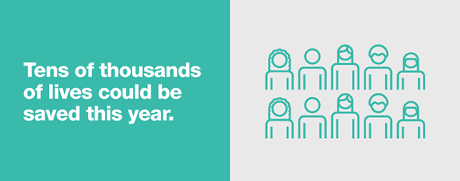
Increasing R_{x} adherence
11
Notes:
One of the most important avenues to improve quality, cost and access is rooted in pharmacy care. Traditionally people have thought about pharmacies as pill dispensaries.
Pharmacy is much more than that.
Pharmacy is extending the front lines of health care to deliver better outcomes more affordably to the people we serve.
Pharmacists help with a broad range of counseling and interventions. One of the biggest opportunities we can address is the issue of patients not taking their medicine.
Taking medicines as prescribed, called “medication adherence”, is one of the most effective ways to fight chronic diseases like high blood pressure, diabetes and high cholesterol, yet many Americans don’t follow their treatment plans.
This results in nearly $300 billion in health care costs and tens of thousands of lives lost each year.
There are many reasons people aren’t adherent to their medications – some face financial barriers, while others are troubled by their medication’s side effects. Still others may not understand how (or why) to take their medication.
So, we’re working tirelessly on tools and programs that educate, remind and encourage patients to stay on track with their medications.
*to play the “hidden epidemic” adherence video, click on the image or click this link: http://cvshealth.com/epidemic/ (MUST HAVE INTERNET ACCESS)

Slide 12
Curbing R_{x} abuse
Making disposal safer
Educating parents and teens
Preventing overdose deaths
12
Notes:
Prescription drug abuse is a growing problem in communities across the United States, particularly among teens.
In fact, according to the CDC, overdose rates have reached epidemic proportion. Each day, over 60 Americans die because of a prescription drug overdose becoming the number one cause of accidental death in the U.S.
At CVS Health, we’re helping to fight against prescription drug abuse in a number of ways.
We’ve partnered with the Partnership for Drug-Free Kids to support its national action campaign, the Medicine Abuse Project, that is working to prevent half a million teens from abusing medicine within the next five years.
In addition, CVS/pharmacy’s Medication Disposal for Safer Communities Program is helping to keep unwanted medications out of the hands of those who were not prescribed them.
Through this program we have donated more than 400 drug disposal units to law enforcement agencies across the country and collected over 7 tons of unused medications.
And our pharmacists are educating parents and kids on the safe use of prescription stimulants and their potential for abuse.
In certain states, we’ve also recently begun providing and administering naloxone to patients experiencing an overdose from certain prescription painkillers.

Slide 13
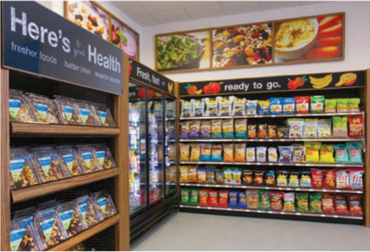
“Better for you” options
Healthier store brand options
New in-store signage to making healthier options easy-to-find
Notes:
To ensure that we are delivering on our purpose of helping people on their path to better health and to meet the changing needs of our customers, we are expanding our selection of “Better for You” choices in both CVS Brand lines and national brands. By offering healthy food and snack options promoted with in-store signage at our 7,800 retail CVS/pharmacy locations, we’re helping to support our customers in meeting their individual health goals and needs.
Our new product line, Gold Emblem Abound, represents one of the ways we are addressing this goal of greater overall health. Each of the 40 snack options are free of artificial flavors and preservatives and each have other beneficial ingredients or characteristics that make them healthier options for our customers.
Also introduced in 2014 was Fit Choices, an in-store signage program designed to help shoppers find food and snack items that suit their individual dietary needs. Products are called out with signage in the aisles and our circular to help customers easily identify the right choices for them.
Our front store has also started to stock more healthy snacks and food options near the register for customers who are eating on the go.

Slide 14
Workforce development investment
20K
Summer Youth
Hires Per Year
20%
Mature Workers (50+ years old) in Our Workforce
14K
Trained in 6 Regional Learning Centers Per Year
1500
Registered Apprenticeship
1M
Pathways to Pharmacy
95K
Moved From Public Assistance
©2015 CVS Health and/or one of its affiliates: Confidential & Proprietary

Slide 15
CRGs build brand ambassadors
2015 Engagement CRG vs. non CRG members (non-store)
15
Notes:
Across all items, colleagues who participate in the CRGs are more favorable than their peers. The greatest differences (14-15 percentage points) are for the items related to caring about the future of CVS Caremark and discretionary effort to help CVS Caremark succeed.

Slide 16
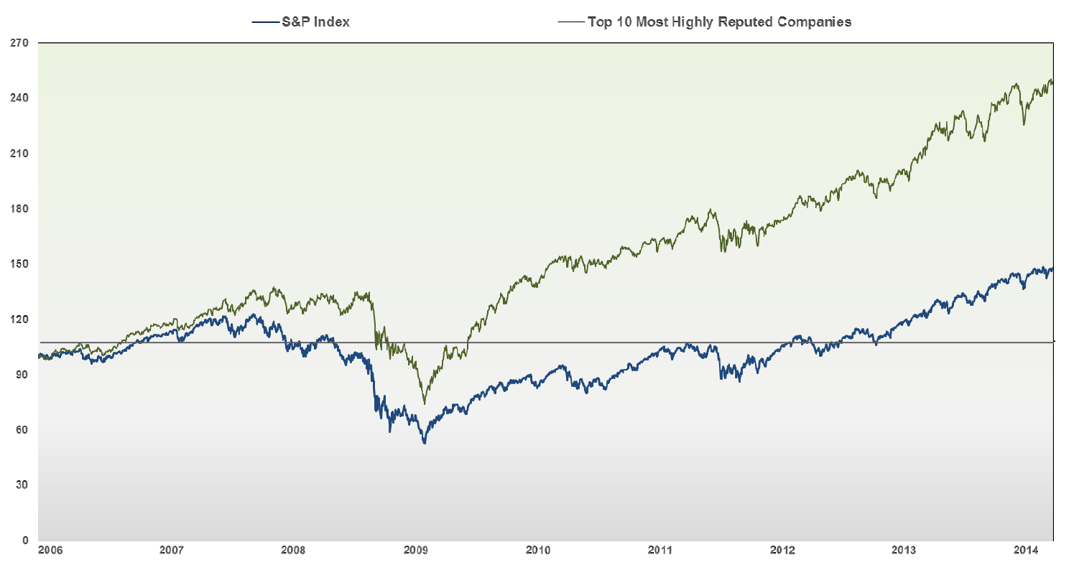
Link between reputation and financials
Companies who invest in a strong reputation experience direct ﬁnancial beneﬁts
The 2015 US Retail RepTrak®: Reputation Leaders in US Retail Industry
Notes:
Companies who invest in a strong reputation experience direct ﬁnancial beneﬁts
• A Strong link between Reputation and Stock Price - Since the 2008 crisis, those companies with a stronger reputation have performed signiﬁcantly better (almost 2X the return) than the overall market.
• Better Stock Price Recovery after a Crisis – all ﬁrms take a similar hit (8%) on average, but higher reputation forms bounce back faster and go higher afterward
• Beneﬁt of the doubt in a crisis - 54% would give reputable companies the beneﬁt of the doubt in a crisis compared to only 20% for lower reputation companies. (RT100)
• Inﬂuence on policy making - companies with better reputations are invited to provide input to policy makers when new regulations are designed
• Access to acquisitions - buyers with better reputations are approached more often, are more likely to get the deal done and at a better price
• More recommendation - recommendation goes up by 6.5 percent for each 5-point reputation RepTrak® score improvement (RT 100)
• More Buying – propensity to buy goes up over 5% for each 5 point RepTrak® score improvement
• Attracting the best talent - a good company reputation is a top 5 driver for people when they consider which company they would like to work for. A higher reputation results in a signiﬁcant increase in willingness to work for a ﬁrm
• Higher Employee Engagement and Alignment - a good company reputation is a key driver for employee pride and engagement. A strong reputation is a leading indicator for employees willingness to deliver on the company strategy

Slide 17
“Regarding the stock's future course, although almost any stock can fall in a broad market decline, investment analysts generally believe that CVS should continue to move higher despite the fact that it has already enjoyed a nice gain in the past year.” (Hodge, 2014)
2015 Cigarettes Out. Health In. An analysis of the rebrand of CVS Health . Arthur W. Page Society Case Study Competition
Notes:
According to The Street, compared to its closing price of one year ago, CVS Health's share price has jumped by 38.45%, exceeding the performance of the broader market during that same time frame. Regarding the stock's future course, although almost any stock can fall in a broad market decline, investment analysts generally believe that CVS should continue to move higher despite the fact that it has already
enjoyed a nice gain in the past year (Hodge, 2014). For 2014, the company is expecting to generate operating cash flow of between $7.4 billion and $7.7 billion, with free cash flow of between $5.7 billion and $6.0 billion
As of November 2014, there is a 13% likelihood that U.S. adults would consider shopping at CVS the next time they go (Marzilli, 2014). This is up from a 9% likelihood in the beginning of 2014

Slide 18
Thank you
18
Notes:
As I wrap-up here tonight, we’ve seen that “health” can mean so many things. Because, health is personal. For me, it could be access to healthy affordable food options. For you, it could mean quitting smoking and staying quit. Or, receiving support and medication counseling to help stay on track with your prescriptions. It’s also fostering safe, communities and providing important health care services to those in need.
But, regardless of how you define “health,” it matters to every individual. Whether you are a patient or a caregiver. Whether you are a mom, dad or grandparent.
And, because we’re present in so many moments, in people’s lives and within the communities where we live and work, we are working to help people on their path to better health. Whatever that means for them.
We are also working to shape the future of health care for people, business and communities by doing our part to provide better, more accessible care to people young and old across the country.
Because to us, health is everything.
Thank you very much.

