Slide 1
Resources
For technical assistance: If you can’t see slides, can’t hear, etc., please use the text-chat box in the bottom right-hand corner of your screen.
For non-technical issues: Please email Customer Service at customerservice@diversityinc.com.
You may submit your questions via the “Questions Pane”: Please use the questions pane to enter and submit questions for the speakers.
For those in need of captioning services: There is a link in the chat that will direct you to a page for live captioning.
Access recording: This recording and recap will be available for download in 72 business hours. If you have questions, email us at customerservice@diversityinc.com.

Slide 2
2023 Top 50 Survey Prep

Slide 3
2023 Top 50 Survey Prep
Dr. Chris Parker
Head of Research & Data Analytics

Slide 4
Agenda
First Steps
What’s new?
What does the assessment cover?
Navigating the Platform
Q&A

Slide 5
First Steps
Did you receive your assessment? If not, go to tinyurl.com/2zs7dmr9 to request one.
Is your company eligible for the Top 50 Competition?

Slide 6
DiversityInc Top 50 Competition Eligibility
To be eligible for a spot on any of DiversityInc’s lists, participants must:
Have a minimum of 750 U.S. employees.
Enter data for your U.S. employee population and initiatives via an online assessment tool.
Submit a verification letter signed by either the CEO, the Chief Human Resources Officer (CHRO) or a corporate officer (other than the Chief Diversity Officer or person responsible for diversity & inclusion) affirming that all data submitted is accurate.
Link to the verification letter is provided at the end of the assessment, which will direct you to a DocuSign form. You will be able to send to the correct party to sign to complete this requirement.
Complete NOD’s Disability Employment Tracker.
Have at least one employee from the company participate in the Top 50 Event.

Slide 7
What’s New?
We are now using Momentive to power our assessment!
The assessment is condensed, reducing completion time
Participants can manually enter or upload a pre-defined XLS template for human capital metrics. This allows for convenient offline collaboration.

Slide 8
What does the Survey cover?
Our assessment covers six key areas of diversity and inclusion management.
Human Capital Diversity Metrics: gender and racial/ethnicity breakdown of representation in overall workforce representation, overall management, senior management, new hires, promotions, and 10% highest paid populations.
Leadership Accountability: CEO/senior leadership commitment and accountability, board of directors, office of diversity and inclusion, diversity council practices, and representation metrics.
Talent Programs: employee resource groups, mentoring, high potential and sponsorship programs, practices, and participation metrics.
Workplace Practices: talent acquisition, talent management, onboarding, diversity training, workforce development and engagement, LGBTQ, people with disabilities, military community, and employee benefits policies and practices.
Supplier Diversity: spend with companies owned by people from underrepresented groups, accountability, and practices.
Philanthropy: contributions to non-profit organizations focused on people from underrepresented groups, employee volunteerism, and matching programs and practices.

Slide 9
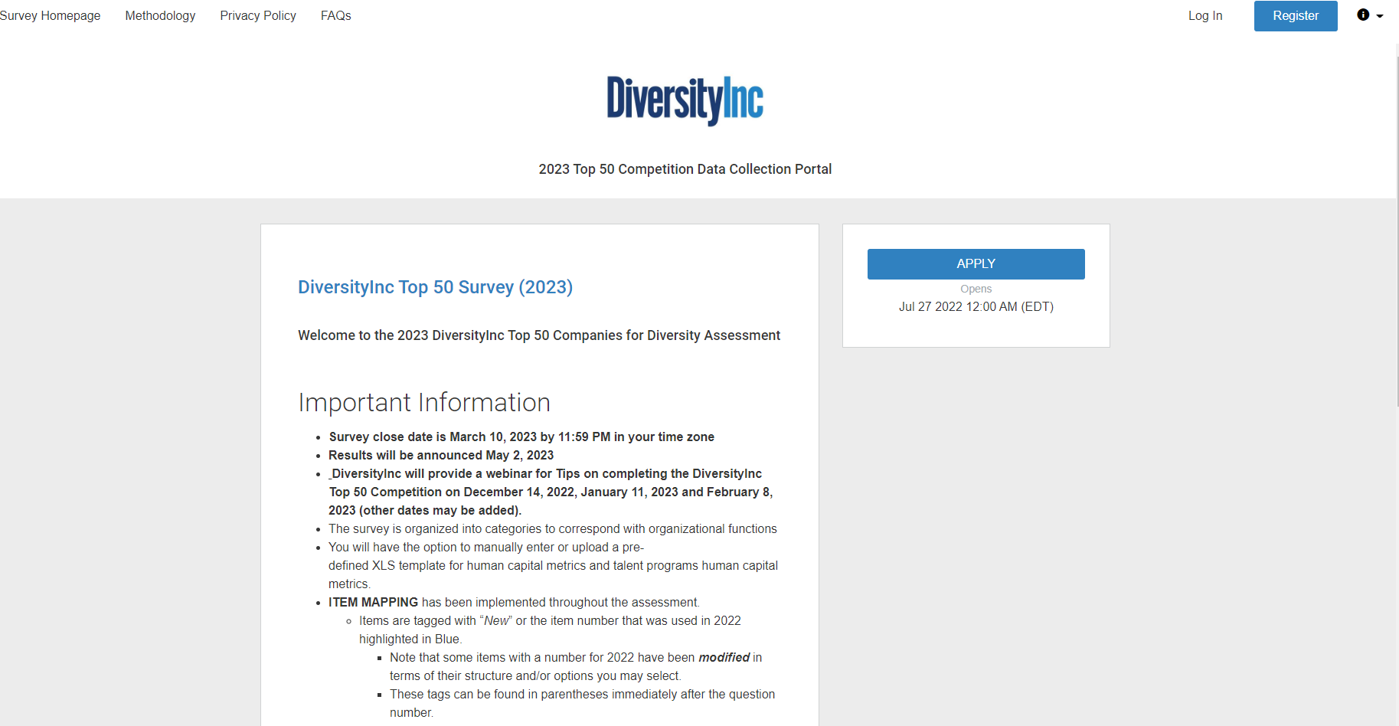
Navigating the Platform
Step 1
Register if it’s your first attempt at completing the assessment. Otherwise, login using your previous credentials, which direct you to step 6.

Slide 10
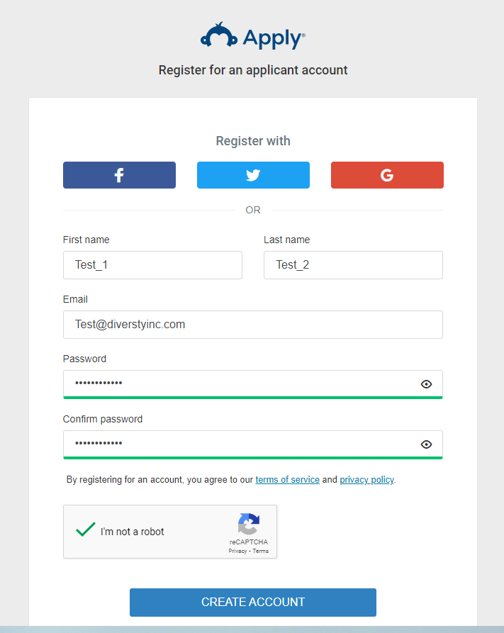
Navigating the Platform
Step 2
Enter the submitter’s info and then create an account for your organization

Slide 11
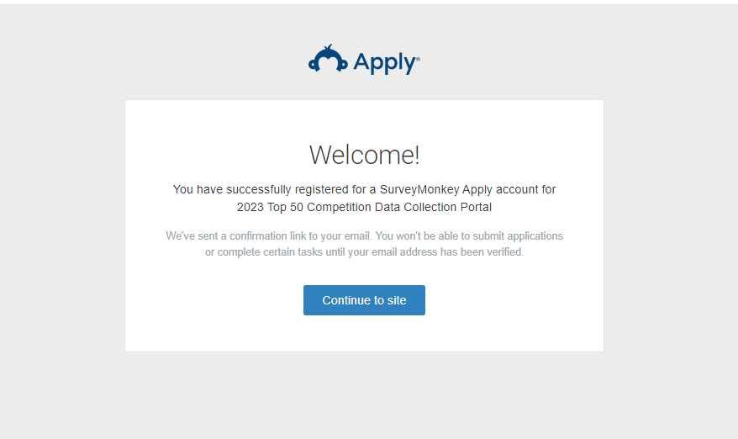
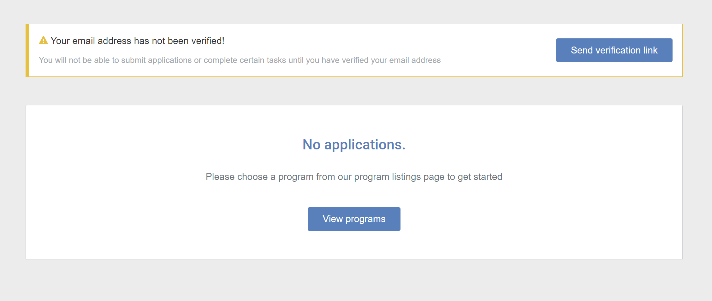
Navigating the Platform
Step 3
1. Click here
2. Verify your email
3. Then click here

Slide 12
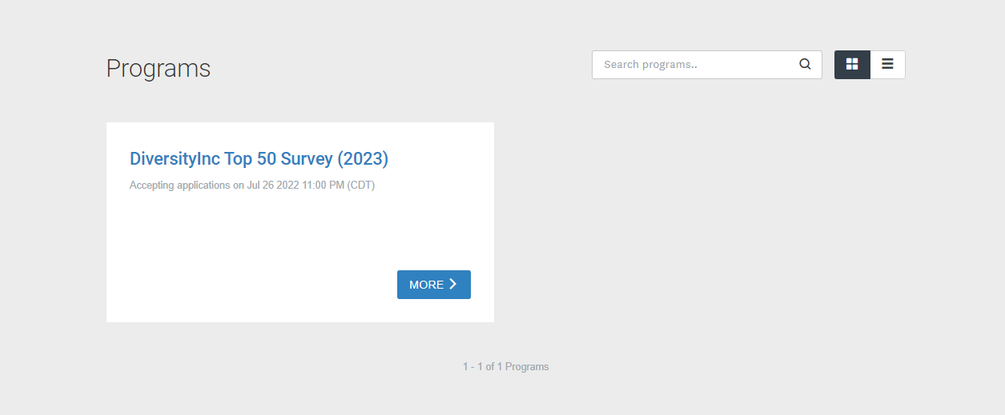
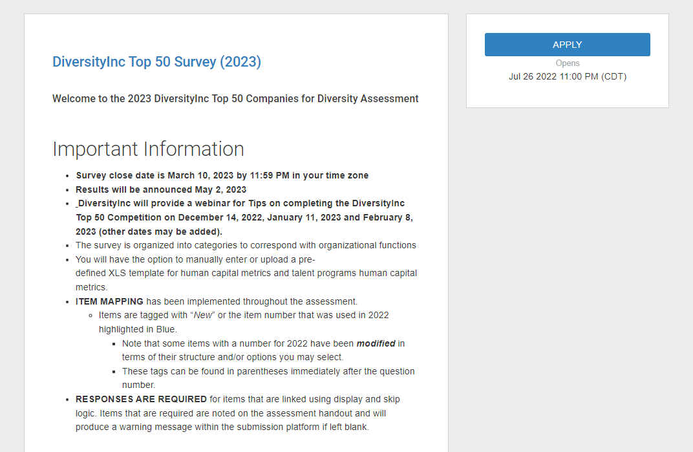
Navigating the Platform
Step 4
1. Click here
2. Then click here

Slide 13
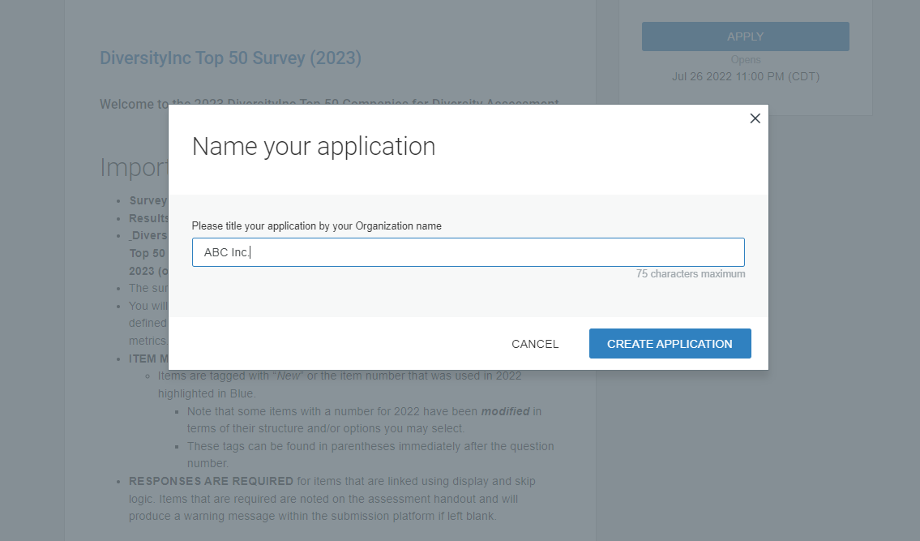
Navigating the Platform
Step 5
Enter your organization title and then create the application

Slide 14
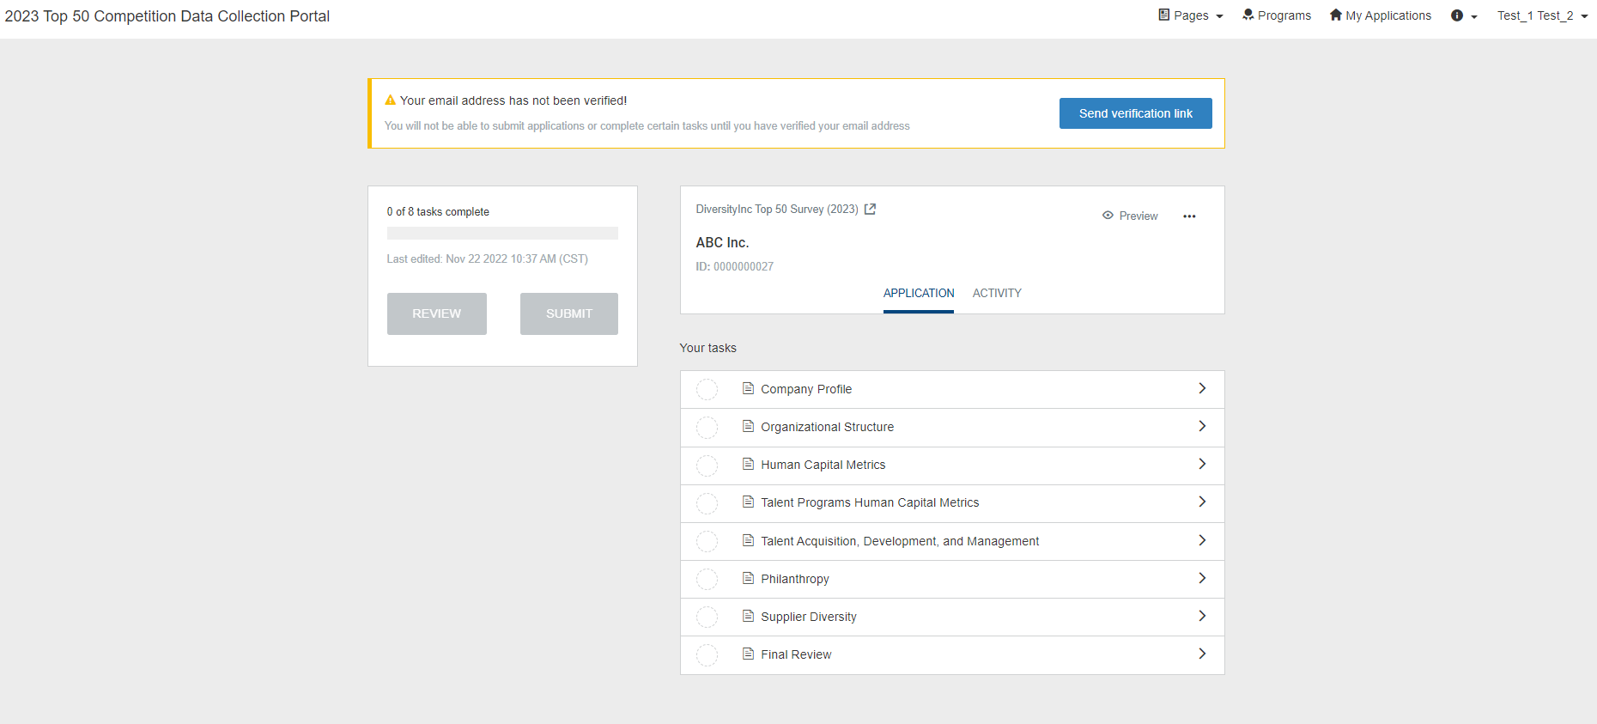
Navigating the Platform
3. Useful information regarding our Methodology, Policy, FAQs, and Instruction
Step 6
2. You can access your credentials and application status in top toolbar
1. You can start inserting data in different sections of the Top50 assessment

Slide 15
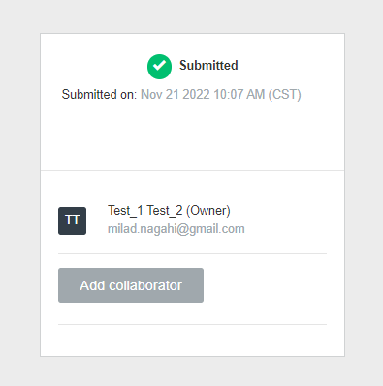
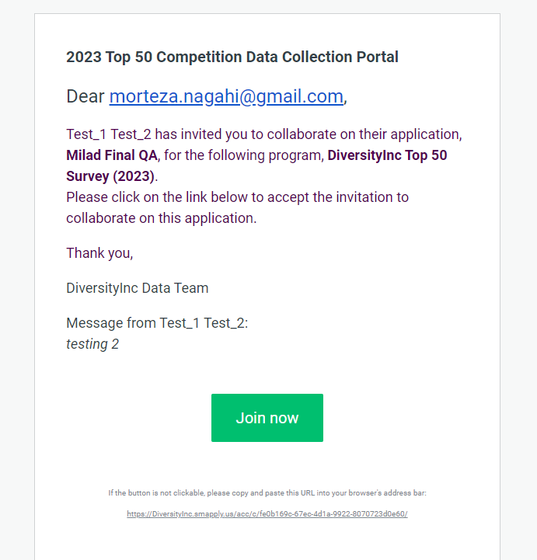
Navigating the Platform
1. You can invite collaborators
Step 7
2. Use collaborators’ email for invitation and define the type of access (you can change/ revoke the granted access any time)
3. Collaborators can join through the provided link

Slide 16
Navigating the Platform
Steps for Adding a Collaborator:
Collaborators invite
Within your application on the left-hand side of screen, click on the “Add Collaborator” button. Upon doing so, you can enter the email address of the collaborator you are adding, set the permissions of the user to View & Edit or View Only and provide an optional message to the collaborator.
Collaborator receives the invite
Once the invite is sent, the collaborator will receive it at the email address provided by the applicant. Within the email, the collaborator will be able to “Join” the application or “Decline” the invite.
Upon clicking Join Now within the email, the collaborator will be able to either Login or complete the registration process, depending on if they already have an account.
Once they have logged in, they will be successfully added as a collaborator to the application.
Collaborator completes required tasks
After the Collaborator has accepted the request and logged in, they will have access to the application. Their permissions will depend both on the settings that have been given to the task as well as the permissions set by the applicant.

Slide 17
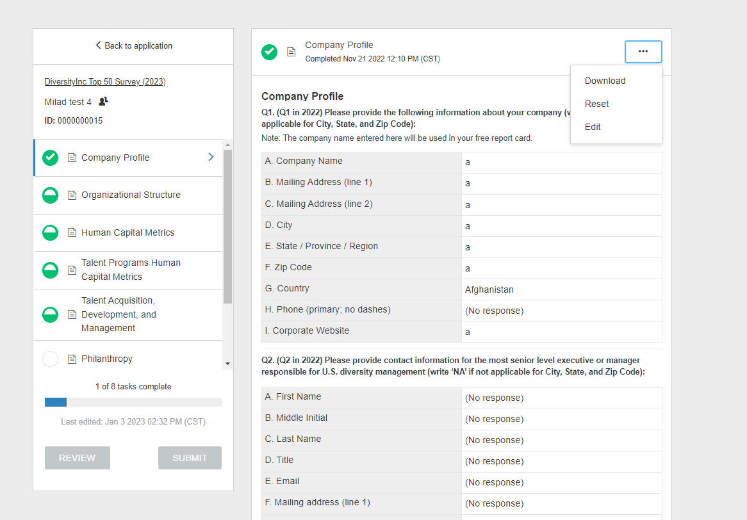
Printing Completed Tasks
By clicking on three dots, you can download a copy of a completed task, or even you can edit a completed task (if a new modification/update needed)

Slide 18
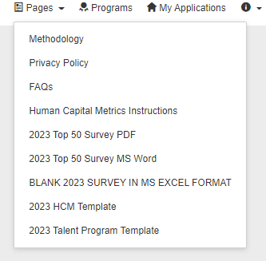
Navigating the Platform

Slide 19
QUESTIONS?

Slide 20
2023 Top 50 Survey Prep
Dr. Chris Parker
Head of Research & Data Analytics

Slide 21
Upcoming Webinars
January 11, 2023
February 18, 2023
2023 Top 50 Survey Prep
2023 Top 50 Survey Prep
2022 Webinar Schedule is now available
on DiversityIncBestPractices.com
SIGN UP TODAY!
SIGN UP TODAY

Slide 22
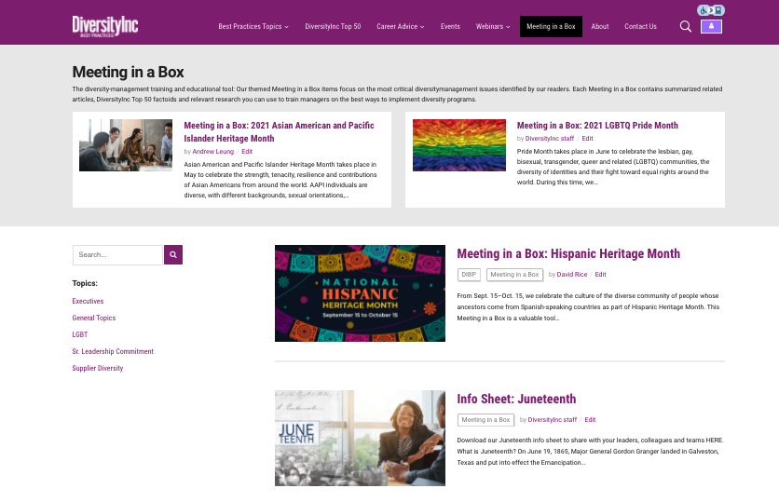
Meeting In A Box
MEETING IN A BOX:
How to utilize our toolkits:
People leaders spotlight various cultures and heritage month celebrations during team meetings and town halls.
Diversity Councils and ERGs share the content and use it to educate employees.
Business teams leverage MIBs for best practices (e.g., Supplier Diversity Meeting in a Box).
Communications teams provide monthly diversity & inclusion content to their organizations.
HR teams and talent teams educate employees on different dimensions of diversity (e.g., people with disabilities and military veterans).
MEETING IN A BOX TOOLKITS
Notes:
Update this slide so it shows recent MIBs

Slide 23
This presentation and recap will be available for download in 72 hours
If you have any questions or comments, please email customerservice@diversityinc.com
Visit DiversityIncBestPractices.com to view past webinars and career advice, as well as relevant, up-to-do-date content on diversity and inclusion management

